Slide 1
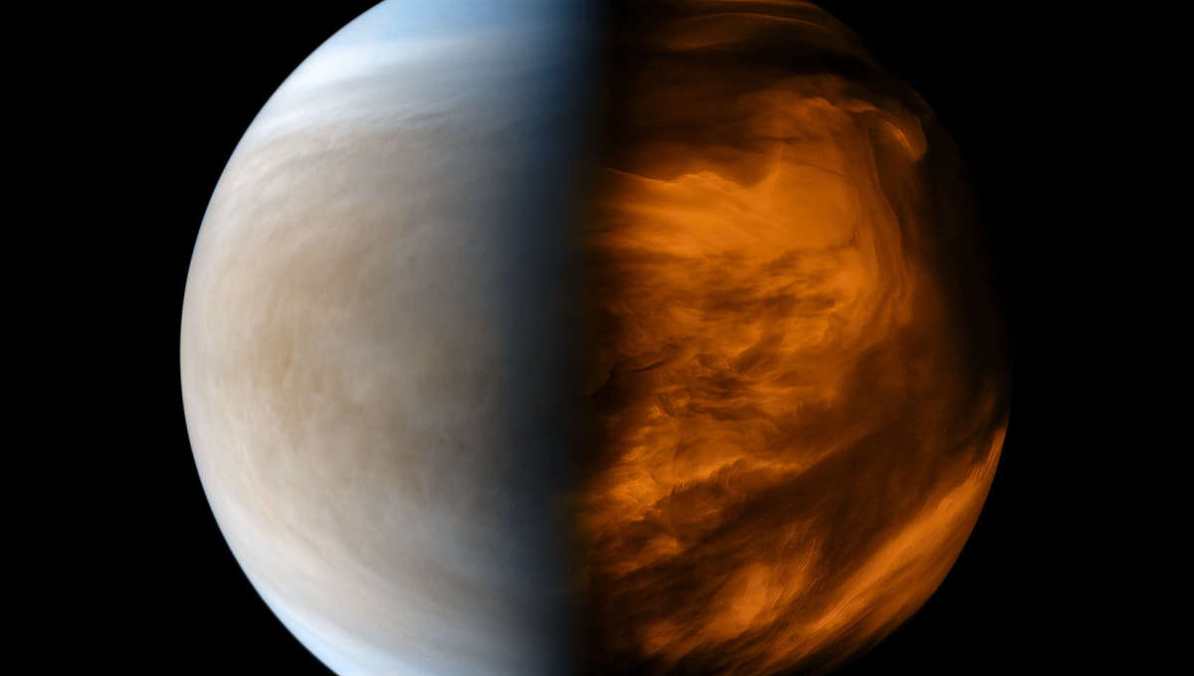
A Panspermia Origin for Venus Cloud Life
Emma Guinan¹, Trevor J. Austin¹, Joseph G. O’Rourke¹, Noam Izenberg², Elizabeth A. Silber³, & Elizabeth Trembath-Reichert¹
¹Arizona State University
²Johns Hopkins/APL
³Sandia National Laboratories
Thanks to: NASA Space Grant & SSW & FINESST

Slide 2
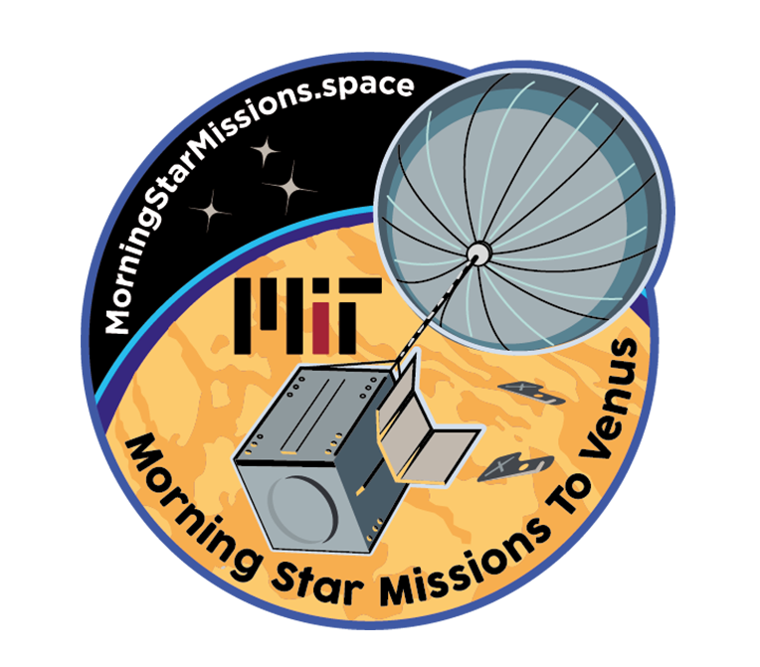
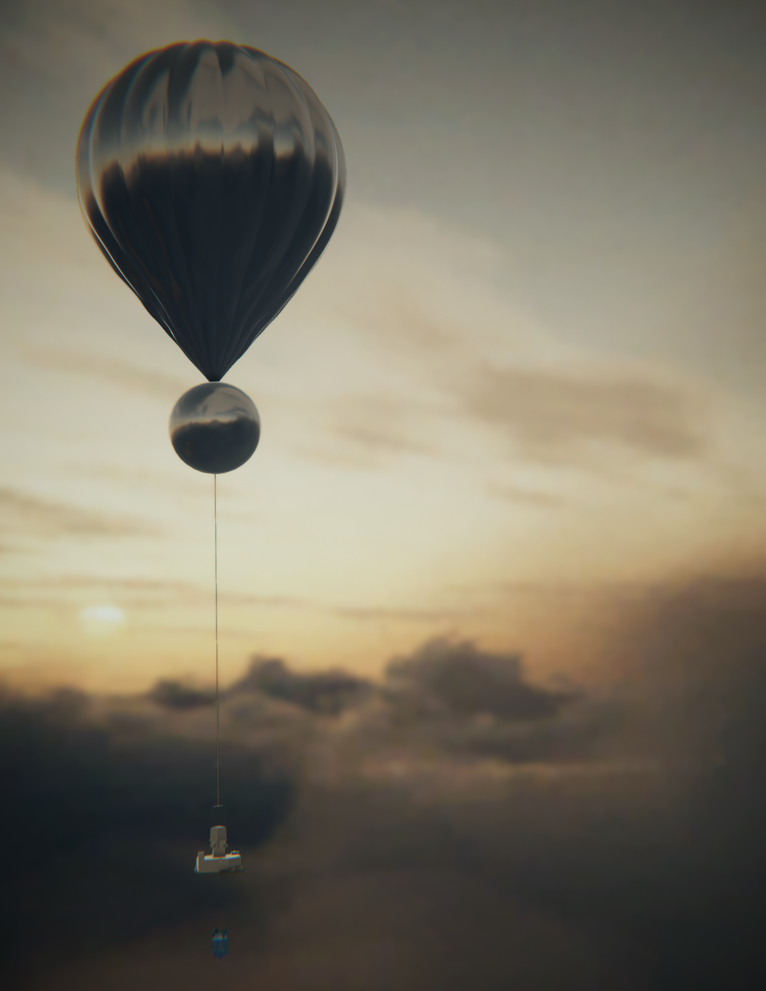
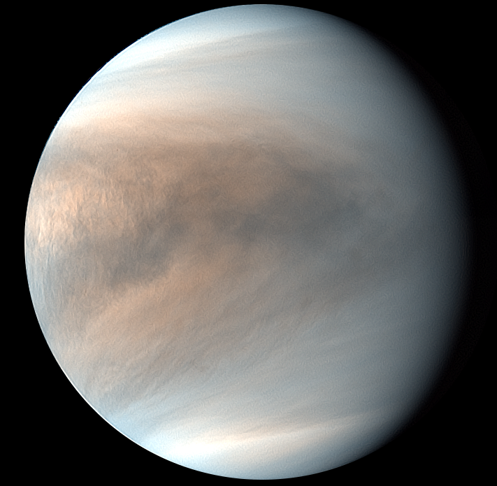
Venus Is a Target for Astrobiology
<NASA/JPL- Caltech
JAXA/Akatsuki>

Slide 3
Life May Have Evolved on Venus…
NASA/JPL- Caltech

Slide 4
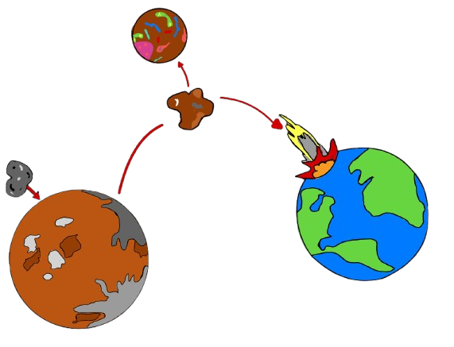
… and/or Travel Between Planets!
Kirschivink & Weiss (2002), Melosh (1997)

Slide 5
Our Goal: Calculate the Flux of Microbes from Earth (or Mars) into the Clouds of Venus
Viable cells delivered (#)
Fraction of impactor mass that is dispersed in floaty fragments
Total mass of impactors (kg)
$$N_{cells}=ρ_{cells} × m_{Venus} ×f_{ablated} × f_{dispersed}$$
Density of cells in the impactors (cells / m³)
Fraction of impactor mass that is NOT sterilized by ablation

Slide 6

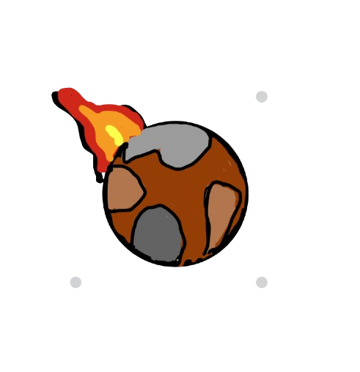
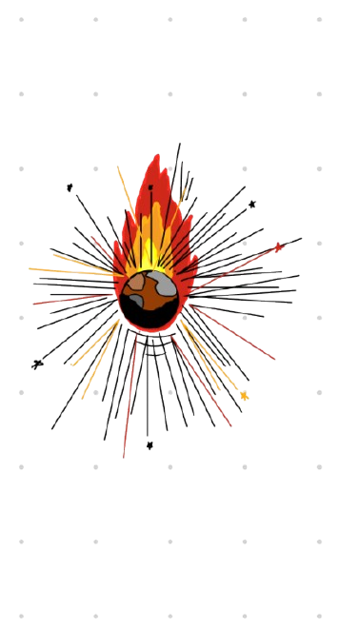
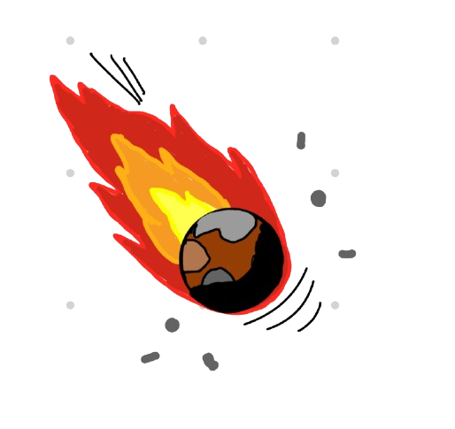
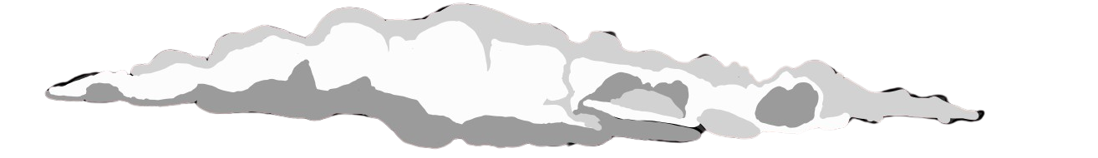
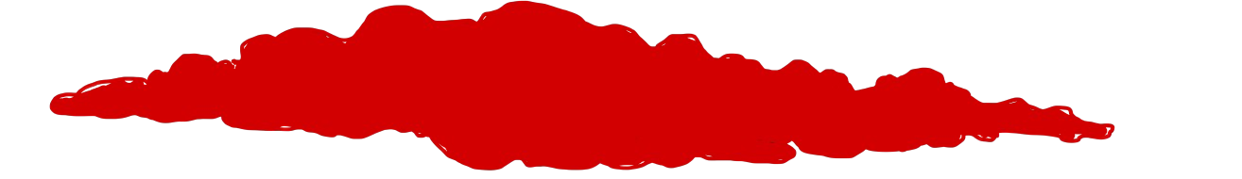
120 km
Bolides scream into the atmosphere
Ablation & fragmentation
AIRBURST!
60 km
Small particles stay lofted
Large particles sink and burn
Surface

Slide 7
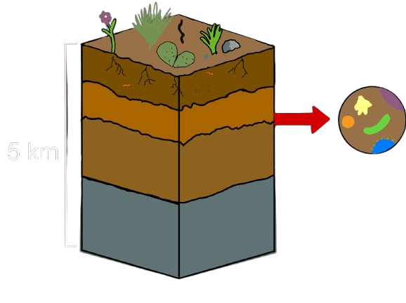

Term 1: Density of Cells in the Subsurface
$5×{10}^{33}$cells total in the top 5 km of Earth (Magnabosco et al. 2018).
Notes:
5*10^33 cells in the total top 5 km of Earth magnobosco et al. 20**

Slide 8
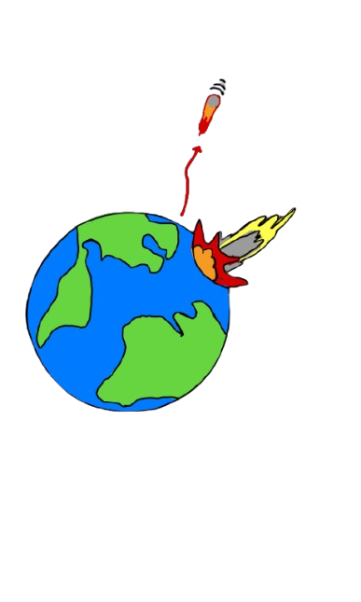
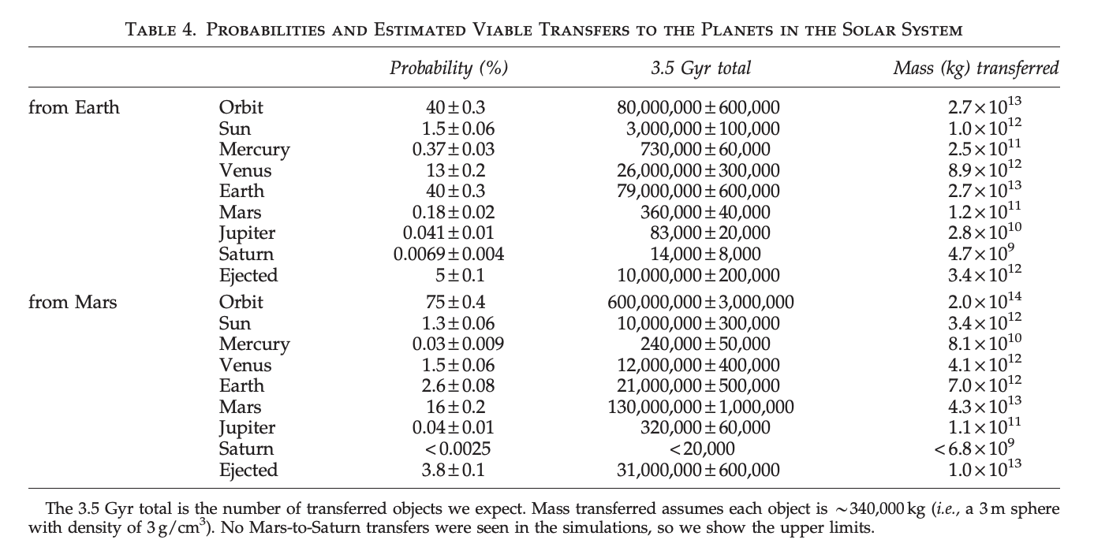
Term 2: Mass Ejected from Earth & Mars
Worth et al. (2013)

Slide 9
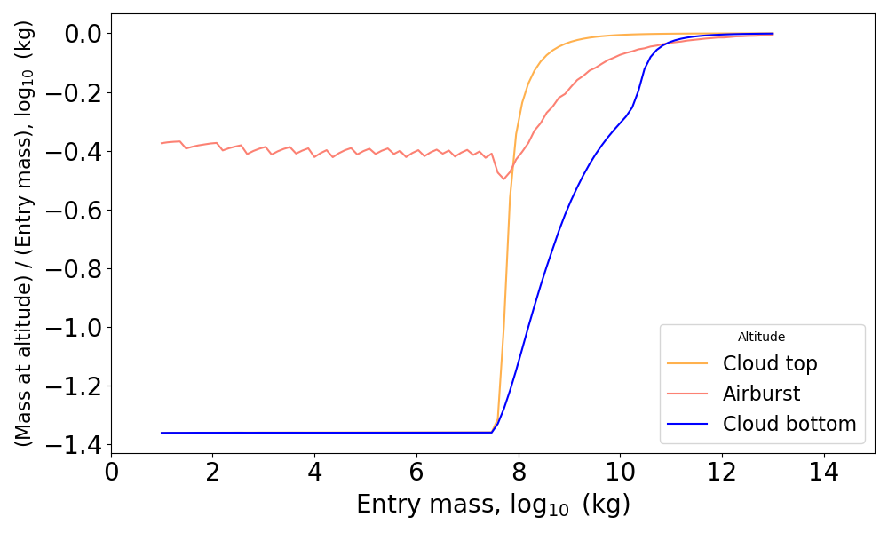
Term 3: Mass that Survives Ablation
Typical bolide mass
Guinan et al. (in prep.)

Slide 10
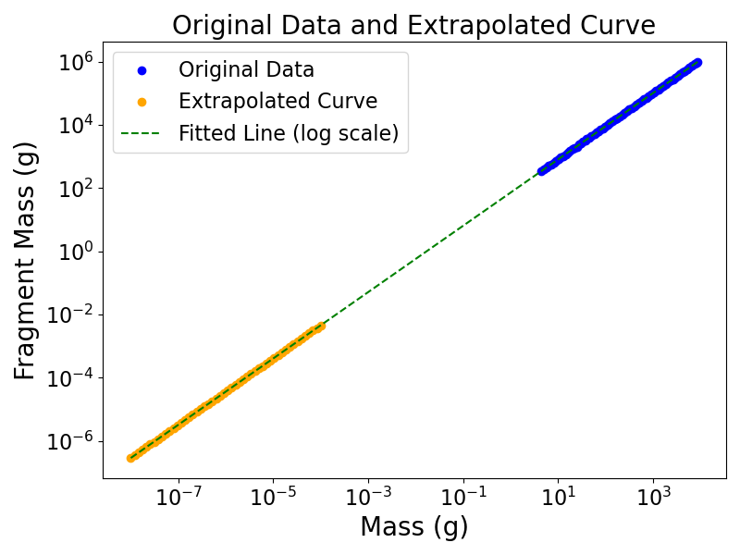
Term 4: Mass Scattered in Small Particles
Extrapolated from Hildebrand et al. (2006)

Slide 11
Our Goal: Calculate the Flux of Microbes from Earth (or Mars) into the Clouds of Venus
$$N_{cells}=ρ_{cells} × m_{Venus} ×f_{ablated} × f_{dispersed}$$
$$N_{cells}={ 10 }^{8}cells/kg × 9×{10}^{12 }kg × 0.4 ×{ 10}^{−10}$$
Bottom line: ~10³ viable cells per Earth impactor, ~10 viable cells on average per Earth-year.

Slide 12
Conclusions
Life on Venus, if it exists, may have come from Earth.
Key points:
Impacts have ejected billions of tons of material from Earth and Mars that subsequently reached Venus
A fraction of that material that could survive atmospheric entry and then disperse as floaty fragments in the clouds
Microbes could have been transferred alive from the subsurface of Earth (and, perhaps, Mars) to the clouds of Venus

